Slide 1
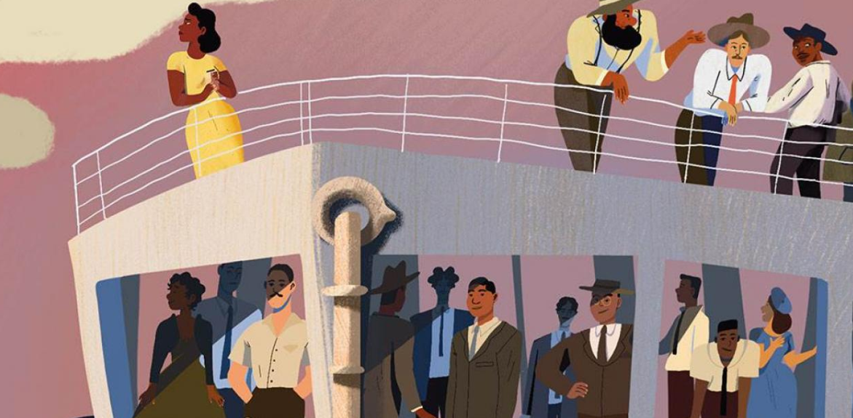
  English – Stories of the Windrush Generation.
RE - Followers of Christ, Belonging to the Church Community & Advent
  Maths – Long Multiplication, Long Division, Fractions & Percentages.
This term in English we will be reading and studying the books ‘Stories of the Windrush Generation’, which we will use to support and inform our writing.
We will build on our vocabulary in order to write descriptions, explanations and narratives, proofread our work spelling and punctuation errors. We will also learn to maintain attention and participate in conversations, speak audibly and fluently when presenting work and consider and evaluate different viewpoints.
We will write numerous texts including poetry, information text, persuasive letter and advert and write from a different viewpoint.
In Guided Reading we will be reading, analyzing and discussing ‘Coming to England’ by Floella Benjamin.
  This term we will learn that Jesus called many people to follow him and will be able to identify reasons why these people responded to his call. We will also talk about some of the challenges of being a disciple of Christ. We will also learn that a direct link exists between the teaching of the Apostles, the role of the Pope and Bishops today and the faith that is celebrated in the local parish community today. Finally, in preparation for Christmas, we will learn that there are two parts to the Season of Advent, understand some reasons why it is important for Christians to prepare and be able to write a modern parable and parts of a hymn about the coming of Christ into the world.
We are going to learn how to:
use their knowledge of multiplicative change to solve problems efficiently
Multiply and divide any integer, including short and long division with decimal remainders.
use knowledge of the best way to interpret and represent remainders from a range of division contexts.
explain how to write a fraction in its simplest form
Add, subtract, multiply and divide fractions and reduce to their simplest form.
Add and subtract related fractions to solve problems in a range of contexts.
Compare pairs of non-related fractions by converting the numerators and denominators.
Explain what percent means.
Convert percentages to decimals and fractions.
Convert a percentage to a fraction.
Use knowledge of calculating 50%, 10% and 1% of a number to solve problems in a range of contexts.
Music – Explore identity through music & song and Christmas.
  This term we are going to identify ways that songwriters convey meaning: through lyrics, the music, and the performance. We will also learn to understanding different ways that rhymes work in songs and understand the concept of identity and how you can express that in songs.
  Geography – Why does population change?
This term we are learning to identify the most densely and sparsely populated areas, describe the increase in global population over time and what might influence the environments people live in. We will also learn to define birth and death rates, suggesting what may influence them, Explain why some people have no choice but to leave their homes and describe the causes of climate change, explaining its impact on the global population.
  .
The Place For Me.
Through studying the books ‘Stories about the Windrush Generation’ and ‘Coming to England’, Year 6 will be learning to answer the question ‘How can we build a more just world together, so that all people are treated fairly and live in solidarity?’
  PSHE – Health and Wellbeing
This term we will learn to identify long term goals and how to work towards them, use mindfulness to manage emotions, understand and plan for a healthy lifestyle and understand the potential impact of technology on physical and mental health, building a resilience toolbox as a support. We will also recognise ways that people can help prevent themselves and others becoming ill and understand what happens when people are ill and know when to seek support.
  Computing – Computing systems and networks.
In computing we will learn to explain that codes can be used for a number of different reasons and decode messages, how to ensure a password is secure and how this works and the importance of historical figures and their contribution towards computer science. We will also Develop an idea for a computer of the future and create a simple design.
  RHE – Me, My Body, My Health.
This term, we are going to learn about our God given gifts and talents, girls bodies, boys bodies and spots and sleep
  PE - Gymnastics.
French – As-tu un animal? (Do you have a pet?)
In PE our focus is gymnastics, developing counter balance and counter tension in group sequences, working with apparatus and formations, developing jump sequences, inverted movements and straddle, forward and backwards roll.
  Science - Electricity
We will be learning to read, write and say the names of different animals, be able to use “J’ai…” (“I have…”) plus a pet name and we will also introduce the connective “et”
This term in science we are learning Construct and draw series circuits using symbols, complete and incomplete circuits, plan and investigate and evaluate a scientific question through an experiment

